Slide 1
Gradual Release

Slide 2
cAVALIERS DON’T OPT OUT
What are some no opt out strategies?
Notes:
Check in, have materials ready, grouping, timer, proximity, Nonverbal cues, verbal cues, and written expectations

Slide 3
I do, We do, you do
Widening the ZPD (Zone of Proximal Development – Vygotsky)
Watch this video https://learn.teachingchannel.com/video/modeling-strategy-getty
Review this resource https://www.washoeschools.net/cms/lib/NV01912265/Centricity/Domain/257/Certified%20Hiring/GradualReleaseResponsibilityJan08.pdf

Slide 4
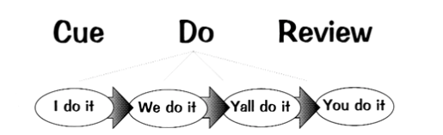

Slide 5
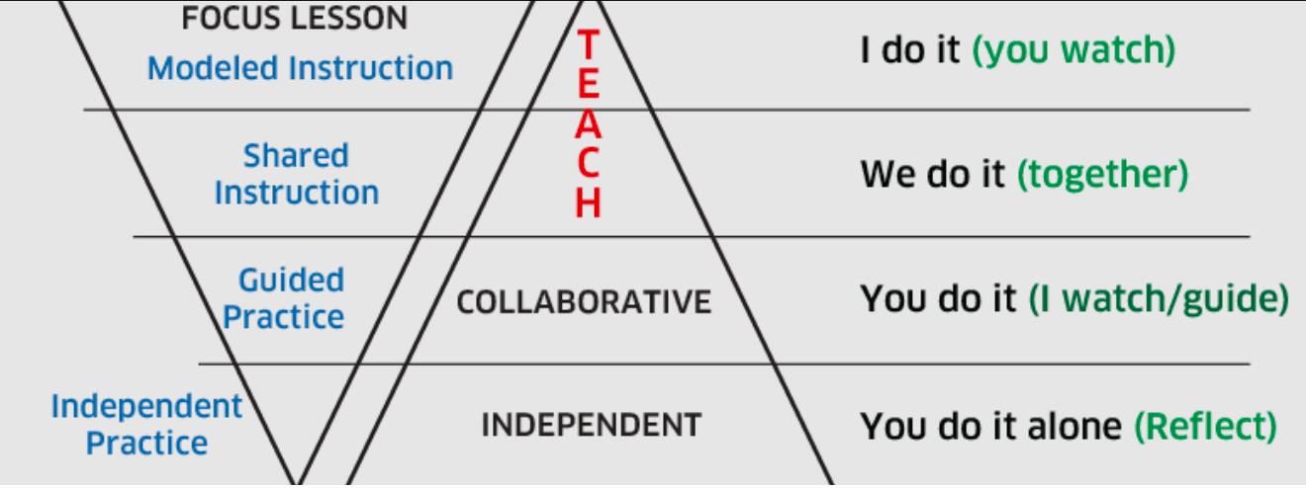

Slide 6
I do
Think aloud
Annotate
Model
Give exemplars (great, good, and bad)
TRAP: A few students participating feels like everyone knows
TRAP: Students on technology not observing but quiet

Slide 7
We do
Class discussion with PLANNED questions, shoulder partners for support
Fill in the blanks
Review the exemplars
Feedback, Feedback, Feedback
TRAP: Students work with no feedback from teacher (check in, proximity)
TRAP: Unclear time allotment (use of timer)
TRAP: Teacher skips this step all together

Slide 8
Researched Based Strategies
https://www.evidencebasedteaching.org.au/high-impact-teaching-strategies/
How can you apply these strategies in the “we do” section?

Slide 9
Y’All do or You Do
Guided instruction to support those who aren’t ready, keep them at “we do”
Use data from the “we do” portion to know who’s ready to move on
Think pair share
Independent practice
Ticket out the door
Switch and check, peer feedback
TRAP: Allowing students to opt out (check ins, proximity, materials ready)
TRAP: Not using Ya’ll do and You do intentionally (grouping)

Slide 10
What does it look like on a plan?
A whole didactic plan can be found here
An example on our template can be found here

