Slide 1
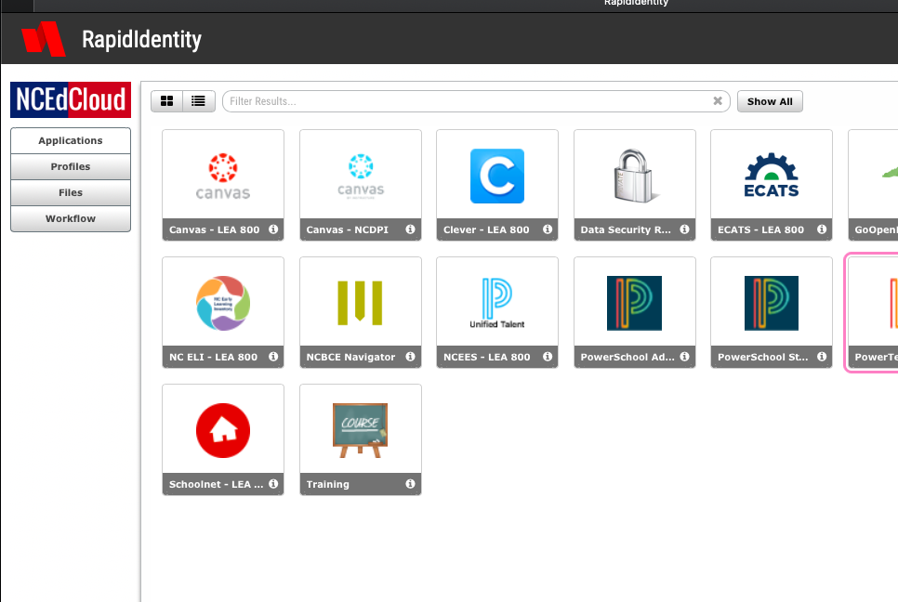
Go into IAM
Click on NCEES – LEA
Blue P icon

Slide 2
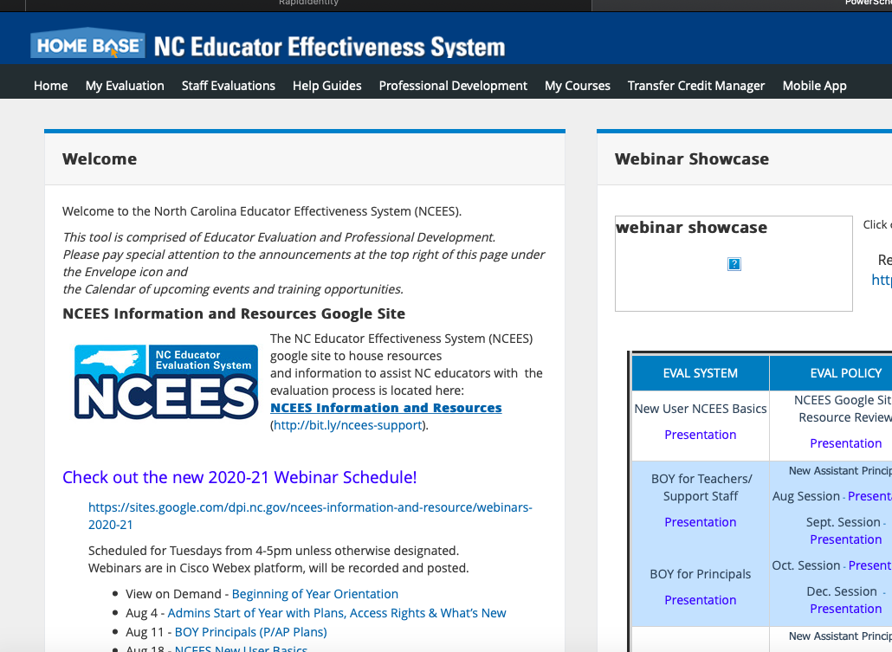
Click on
“My Evaluation”

Slide 3
How to start your evaluation and log the orientation

Slide 4
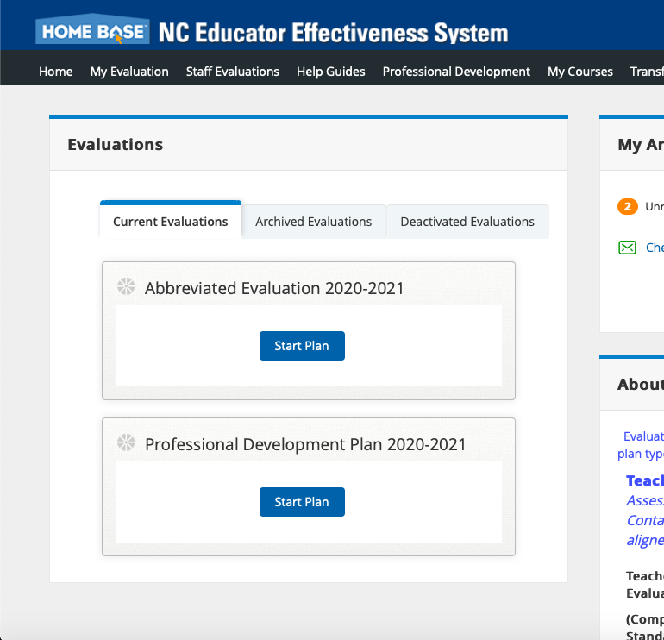
Make sure you have the right evaluation:
Comprehensive: Beginning Teachers
Standard: Renewal Year
Abbreviated: Career teachers not renewal
Click on “Start Plan” under your evaluation

Slide 5
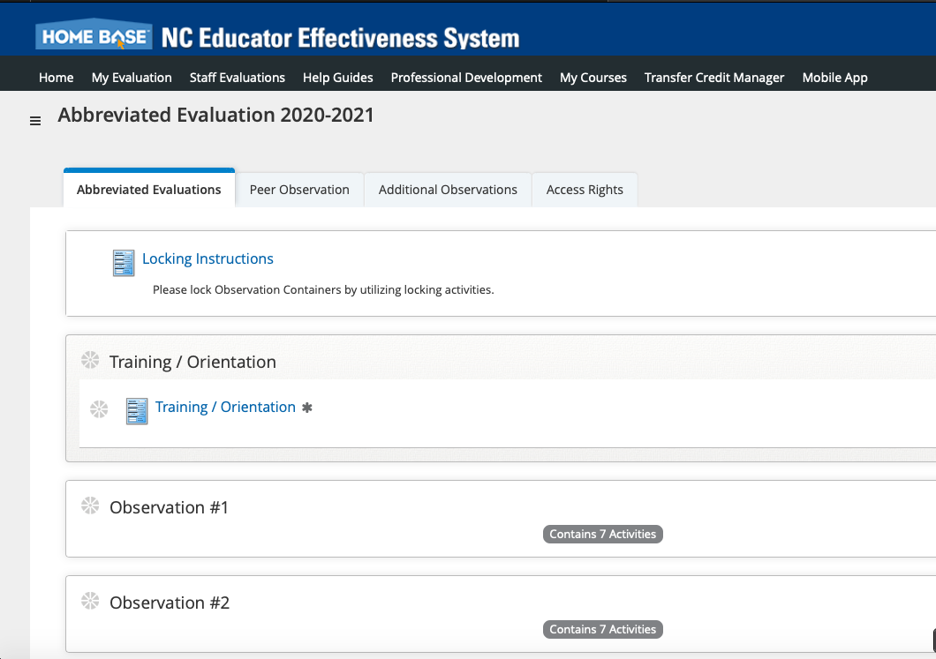
Click
“training & orientation” to open the bucket and again on the blue link
1
2

Slide 6
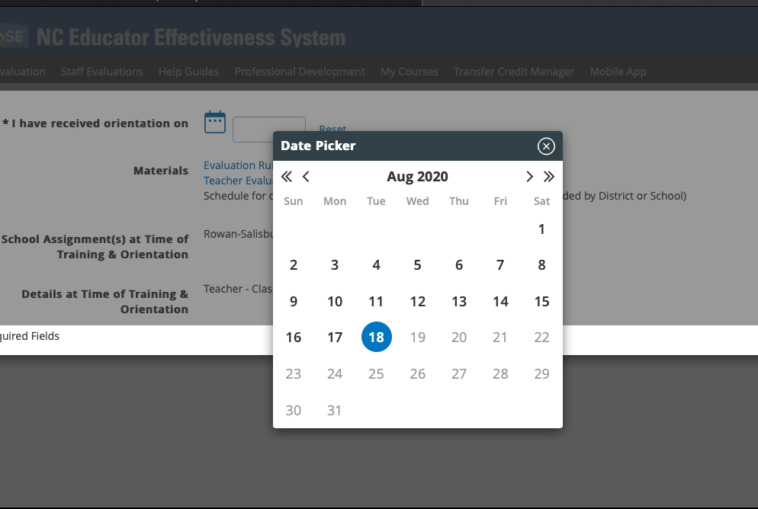
Click on the calendar and today’s date.

Slide 7
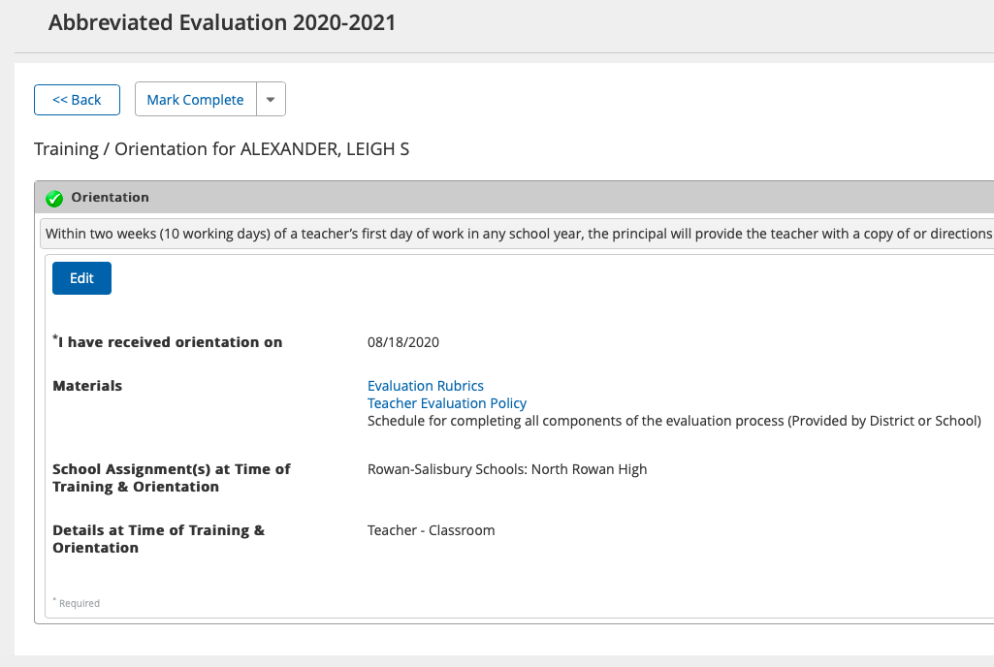
Click
Mark Complete

Slide 8
How to complete your self assessment

Slide 9
Click back on “My Evaluation” to take you to this screen.
Click on “Start Plan” under Professional Development Plan 20-21

Slide 10
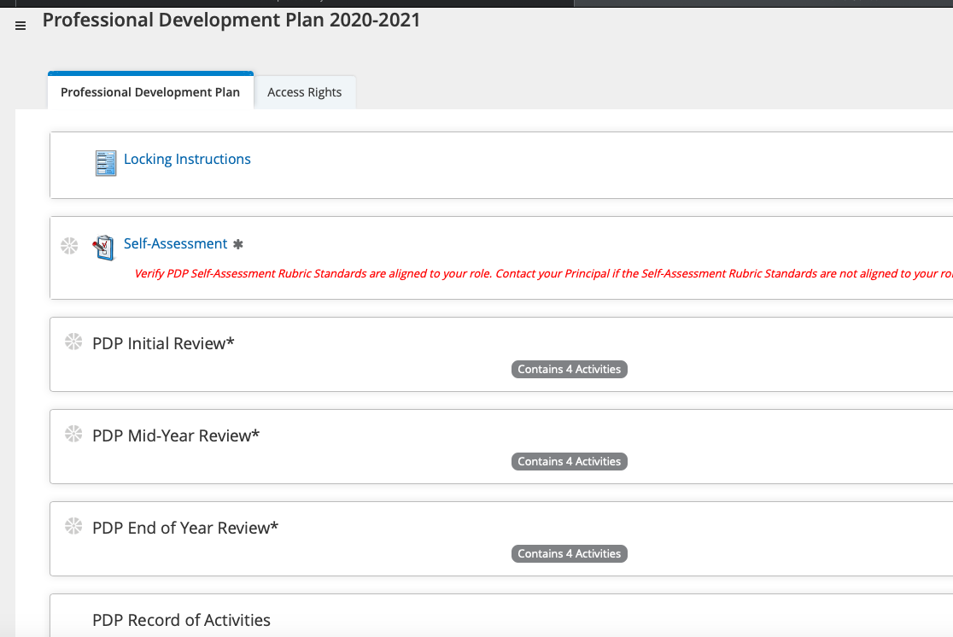
Click on self assessment

Slide 11
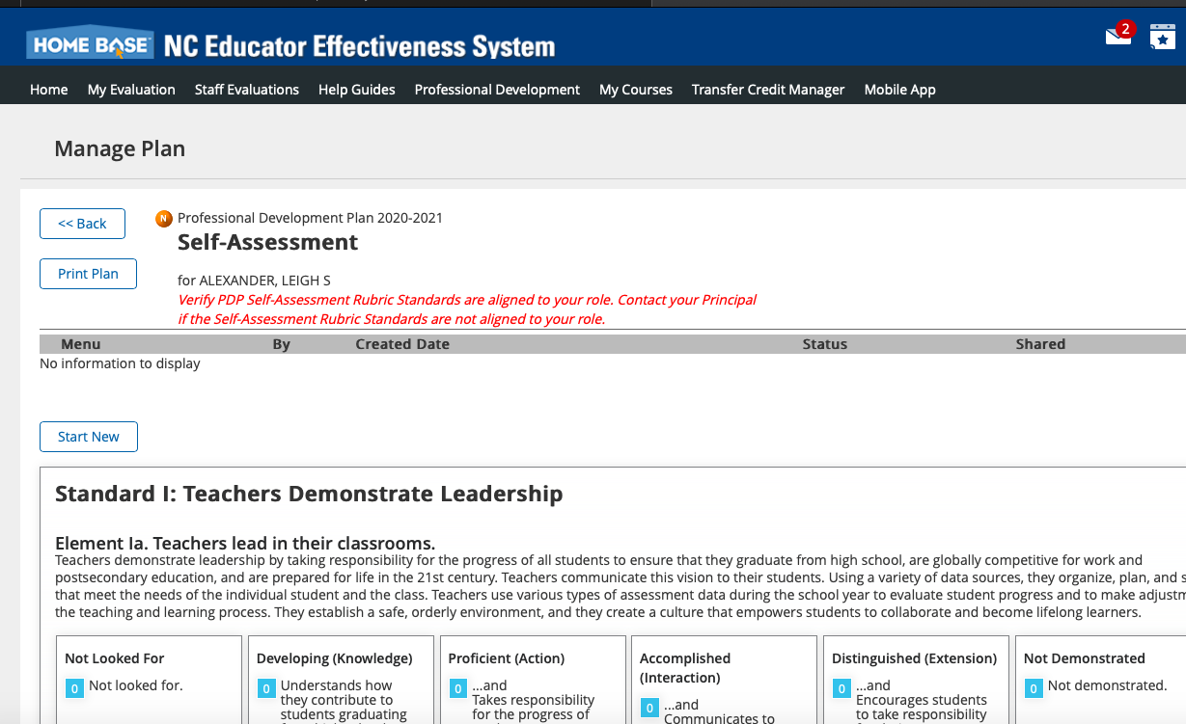
Click start new
Complete the rubric by clicking on the check boxes.
You must mark at least one box for each element.

Slide 12
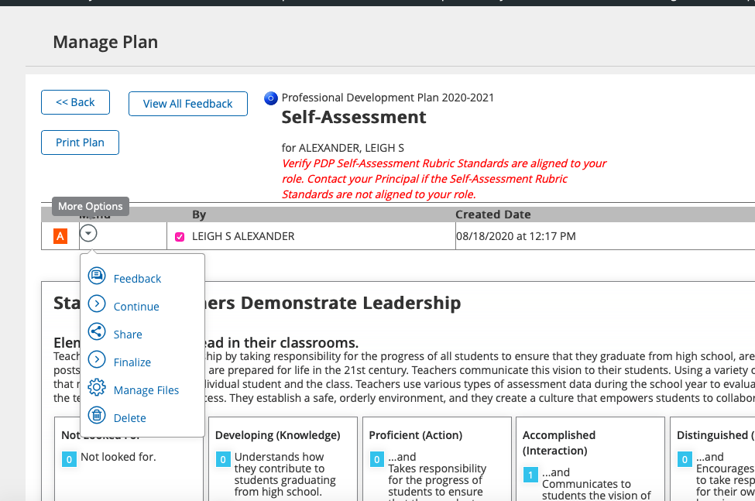
On the little down arrow circle click “Finalize”
If you don’t have the finalize option, it’s because you have missed checking a box for an element.

Slide 13
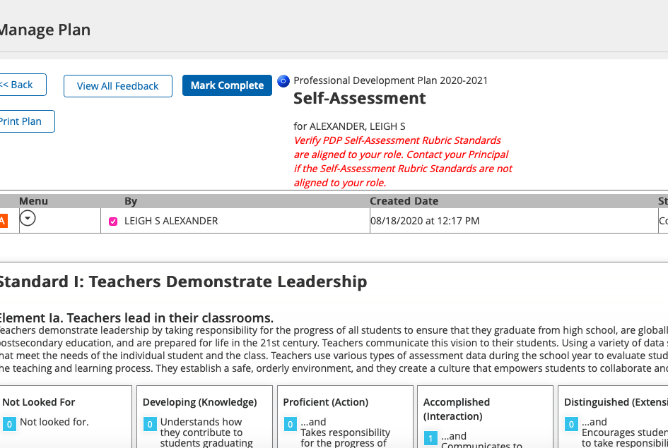
Click
Mark Complete

Slide 14
How to write your PDP goals

Slide 15
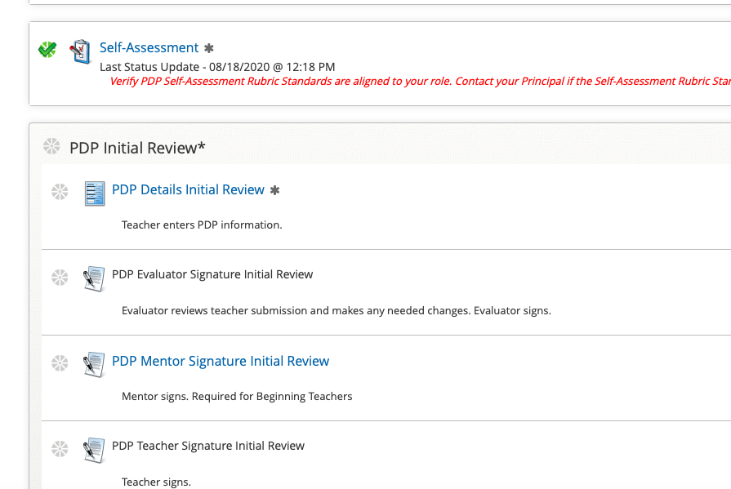
Click on PDP Initial Review
Then click PDP Details Initial Review
1
2

Slide 16
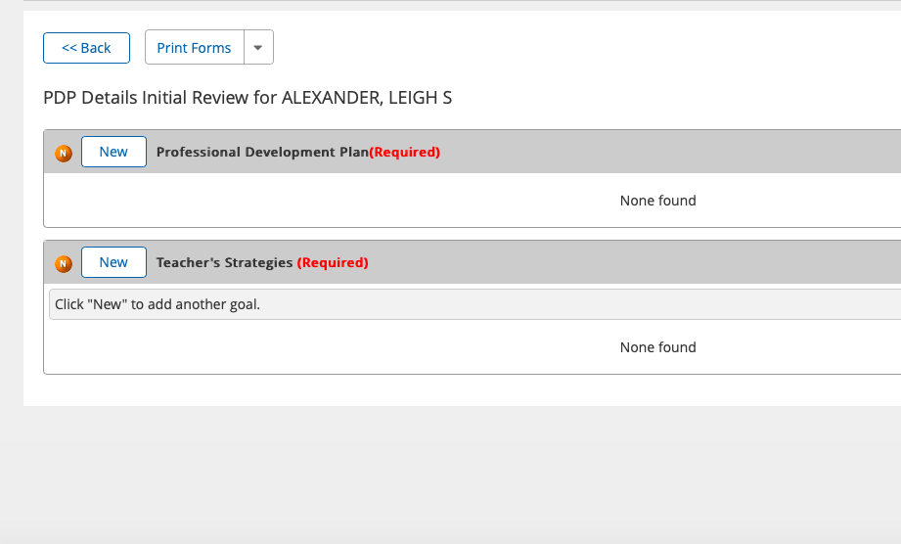
Click on the top “new”

Slide 17
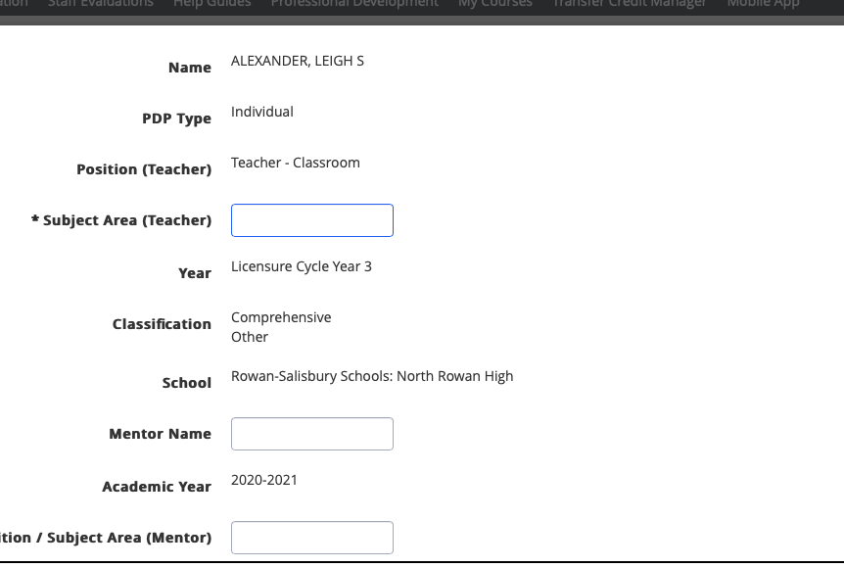
If you are a career teacher just fill in your subject area.
BT’s should add their mentor and mentor’s subject area.
Click submit/save.

Slide 18
Click on the bottom “new” by teacher strategies

Slide 19
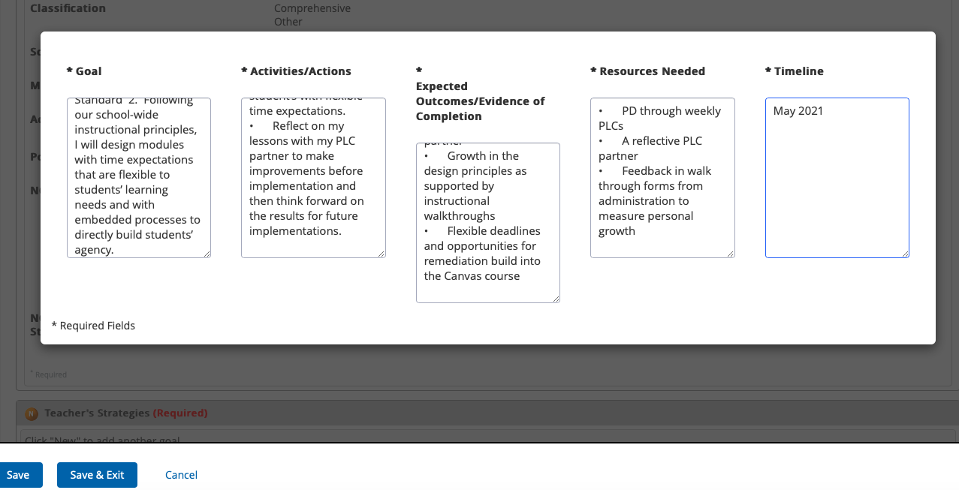
Complete the template with the first prewritten goal. Use copy and paste.
Then click save & exit

Slide 20
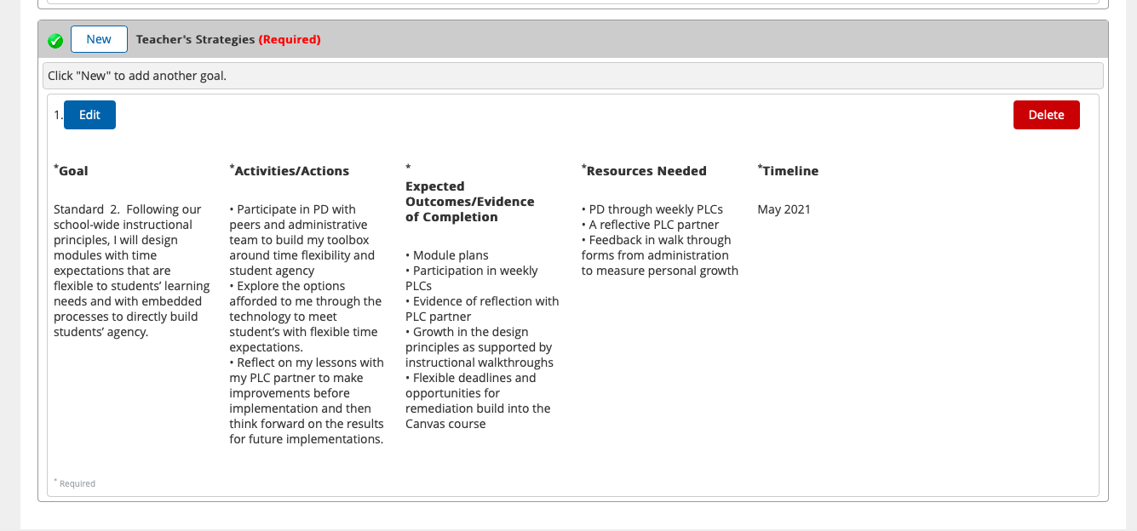
Click new again and repeat the copy/paste process for the second goal.

Slide 21
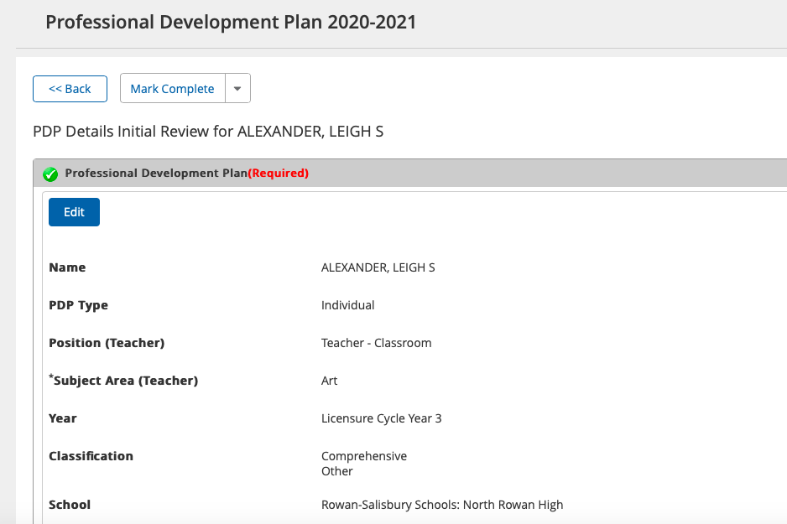
Click Mark Complete

Slide 22
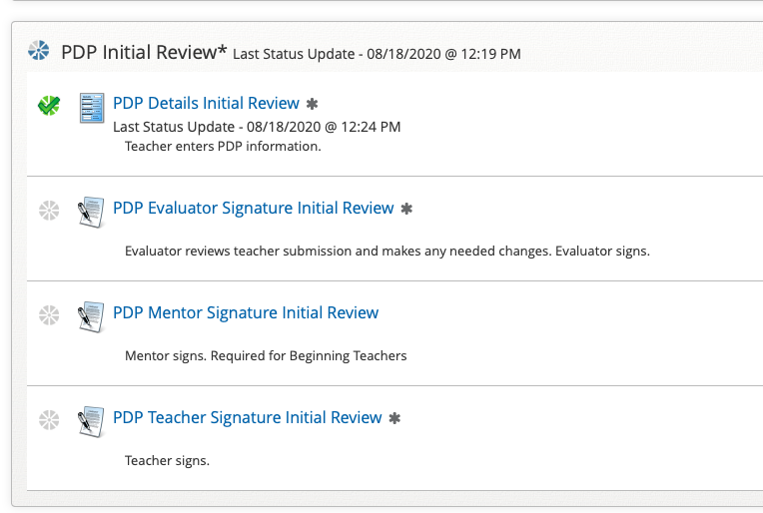
You should have one green check.
Click on PDP Teacher Signature

Slide 23
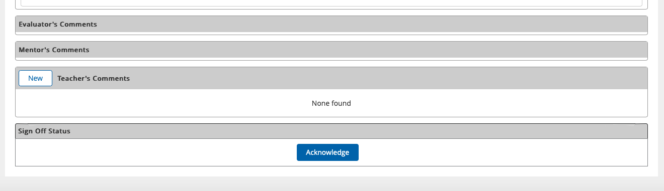
Scroll to the bottom and click Acknowledge

Slide 24
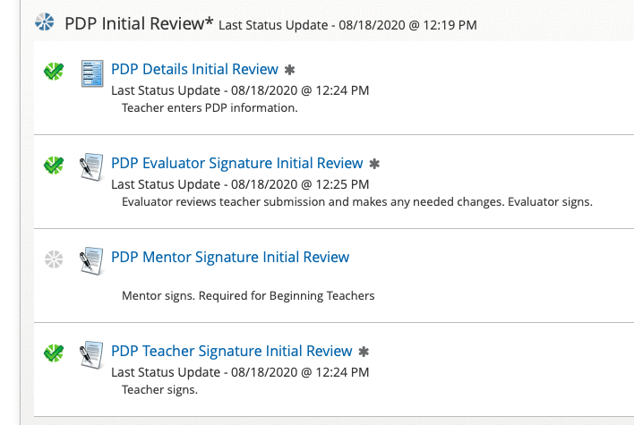
You should have two checks.
Let Mrs. Williams know you’re done and she will make the 3rd.
Williams
You

Slide 25
Great work!

