Slide 1
Show respect always.
Be in the right place at the right time to learn.
Be prepared for and focused on learning.

Slide 2
Grading and Feedback

Slide 3
What is feedback?
Teacher input that leads to greater learning and analysis

Slide 4
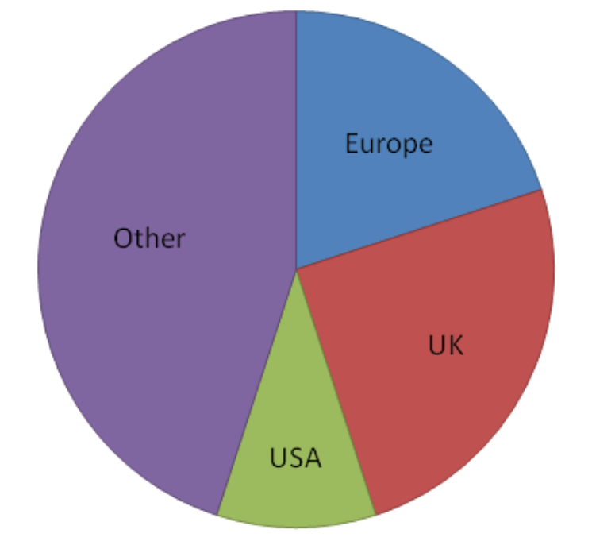
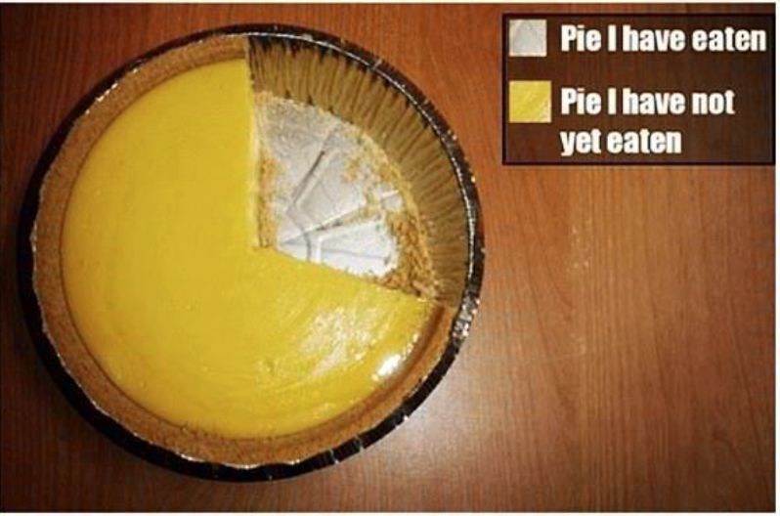
You can create some work….
In your groups, on the given paper, create a pie chart that shows how you would ideally distribute grades. Show what % each of the following types of assignments would be given over the course:
Tests
Quizzes
Classwork
Projects
Final Exam

Slide 5
Switch with another group and give feedback.
Use the red pen for feedback.

Slide 6
Return to the original group.
Discuss the feedback.
How did it make you feel as a “student”?
How did it make you think differently about the work?
How did it or didn’t it encourage your additional learning?

Slide 7
What is feedback?
Teacher input that leads to greater learning and analysis
An invitation from the teacher to the student into a partnership/relationship.

Slide 8
Another example
Use the website to “look up the answers” if you need.
Give this student feedback on their work.

Slide 9
Upcoming: What is GOOD feedback?
Make a list of good characteristics “it is….”
Make a list of negative charcteristics “it is not...”

Slide 10
Switch with another group
Switch with another group
Switch with another group

Slide 11
What is GOOD feedback?
Make a list of good characteristics “it is….”
Make a list of negative charcteristics “it is not...”

Slide 12
What is a GRADE?
The % of the content the student has mastered.
It’s math and it’s percentages….....

Slide 14
Tests 25%
Classwork 30%
Quizzes 25%
Projects 20%
Tests 25 x 0.4 = 10
Classwork 30 x 0.4 = 12
Quizzes 25 X 0.4 = 10
Projects 20 X 0.4 = 8

Slide 15
Quarter 1
Unit 1 Test
Unit 2 Test
1 Quiz

Slide 16
Mrs. Williams’ Suggestions
Do much more feedback than grading
Do much more giving back and taking back up, redos, fixing, improving
Don’t weight your gradebooks within the quarters by types of assignments. (Q3, Q4)
Instead, weight each individual assignment to accurately reflect LEARNING ☺

